Slide 1
Autonomous and cooperative design of the monitor positions for a team of UAVs to maximize the quantity and quality of detected objects
Dimitrios I. Koutras^{1,2}, Athanasios Ch. Kapoutsis²,
Elias B. Kosmatopoulos^{1,2}
¹ Department of Electrical and Computer Engineering,
Democritus University of Thrace, Xanthi, Greece
² Information Technologies Institute,
Centre for Research & Technology, Hellas (ITI-CERTH), Thessaloniki
2020 IEEE/RSJ
International Conference on Intelligent Robots and Systems (IROS)
October 25-29, 2020, Las Vegas, NV, USA
ConvCAO Lab ITI-CERTH

Slide 2
Table of Contents
1. At a Glance
2. Problem Formulation
Controllable Variables
Measurements
Objective Function
3. Navigational Algorithm
Global Coordination
Distributed Decision
4. Evaluation Results
5. Conclusion – Future Work

Slide 3
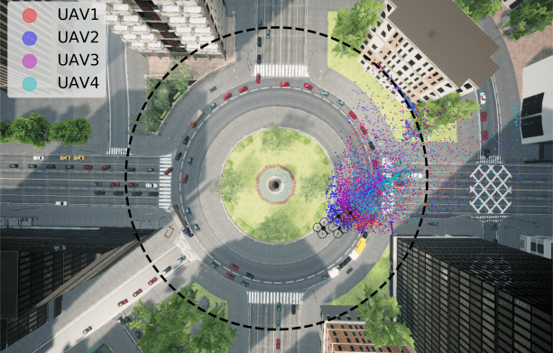
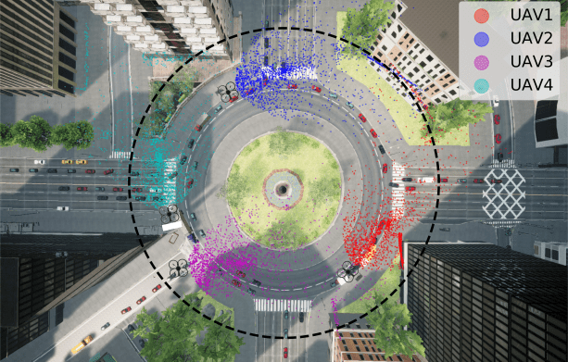
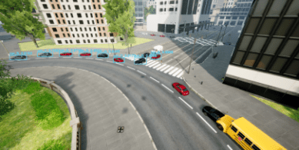
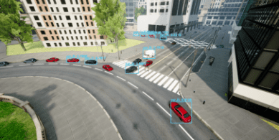
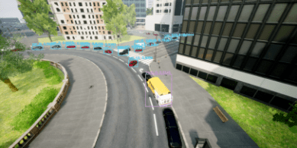
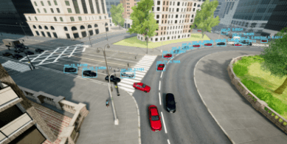
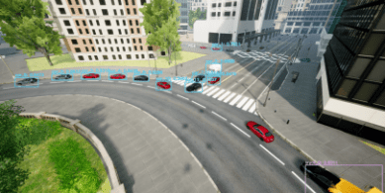
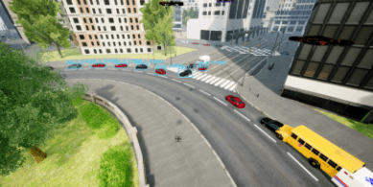
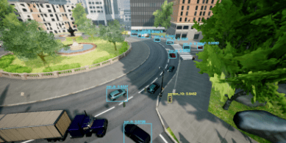
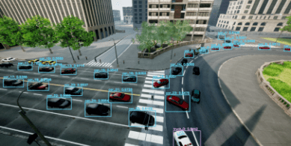
1. At a Glance
UAV 1
UAV 2
UAV 1
UAV 2
UAV 3
UAV 4
UAV 3
UAV 4
Figure 1.1 Example of a single experiment

Slide 4
2. Problem Formulation | Controllable Variables
Consider a team (swarm) of n multirotor UAVs {1,2,…,n}
UAV decision vector: | $x_{i}\left(k\right)=\left[x,y,yaw\right]∈R^{2}×S^{1}$ (1)
Augmented decision vector: | $X\left(k\right)=\left[x_{1}\left(k\right),x_{2}\left(k\right), …,x_{n}\left(k\right)\right]$ (2)
Constrains: | 1) Maximum value
 | 2) Remain in operation area
 | 3) Collision avoidance

Slide 5
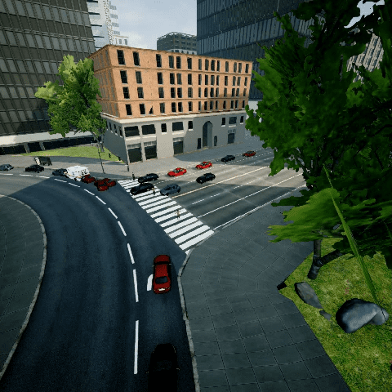
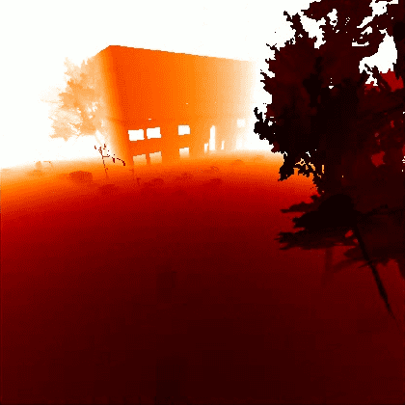
2. Problem Formulation | Measurements
UAV perception: | $$I_{i}^{RGB}\left(k\right) I_{i}^{DEPTH}(k)$$
Figure 2.1: $I_{i}^{RGB}\left(k\right)$
Figure 2.2:${ I}_{i}^{DEPTH}(k)$

Slide 6
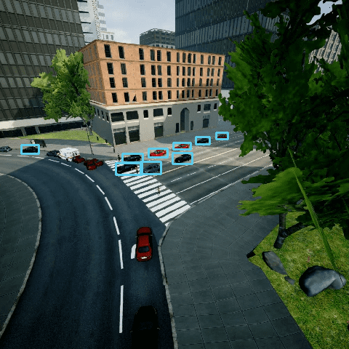
2. Problem Formulation | Measurements
$I_{i}^{RGB}\left(k\right)$ is fed to a Convolutional Neural Network, to detect objects of interest. At each bounded box, image segmentation is performed, to identify which pixels consist the detected object.
Figure 2.3: $I_{i}^{RGB}\left(k\right)$
Figure 2.4: CNN Object Detection
Figure 2.5: Segmentation

Slide 7
2. Problem Formulation | Measurements
3D Reconstruction
Input: | Geolocation Depth Image Focal Length
Output: | 3D Reconstruction
Center of Mass of each detected object can be extracted.

Slide 8
2. Problem Formulation | Objective Function

Slide 9
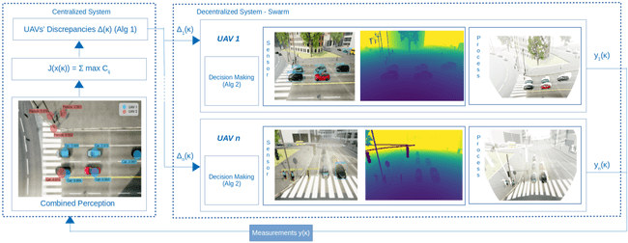
3. Navigational Algorithm
Figure 3.1: Flowchart of the overall navigation scheme

Slide 10
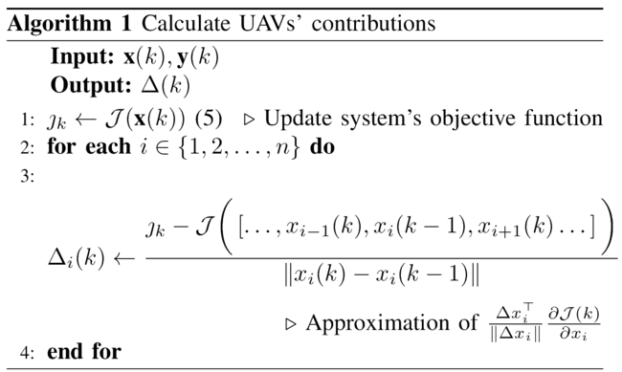
3. Navigational Algorithm | Global Coordination

Slide 11
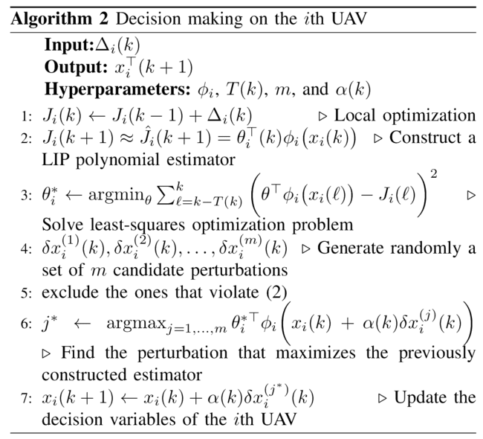
3. Navigational Algorithm | Distributed Decision

Slide 12
4. Evaluation Results | Implementation Details
AirSim: open-source, cross-platform, simulator for drones, cars and more that supports hardware-in-loop with popular ﬂight controllers for physically and visually realistic simulations
CItyEnv: vast, realistic environment, static structures and the highly non-linear and dynamic behavior of the moving assets (e.g. cars, trucks, pedestrians, etc.)
Swarm: UAVs instantiated with the AirSim built-in ﬂight controller (called simple ﬂight) and equipped with stationary cameras (rotated downwards ${45}^{o}$ on the pitch axis).
Object Detection: YOLOv3 detector pretrained on COCO dataset

Slide 13
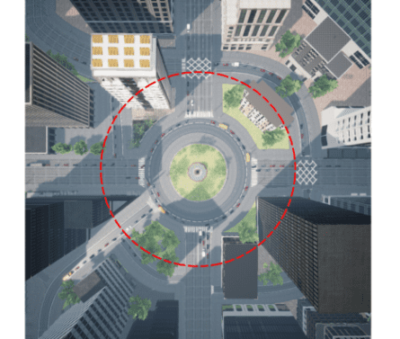
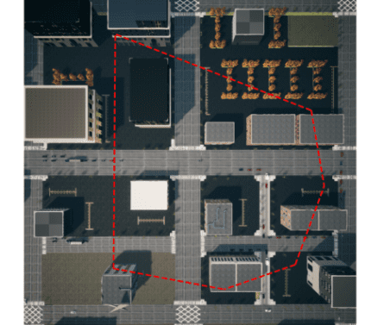
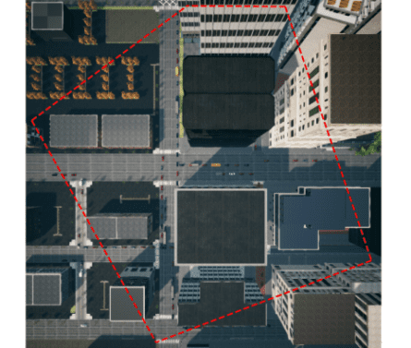
4. Evaluation Results
Area 1
Area 2
Area 3
 | Area 1 | Area 2 | Area 3
Area | 15393.8m2 | 37892.3m2 | 56894.9m2
Experiments | 40 | 40 | 40

Slide 14
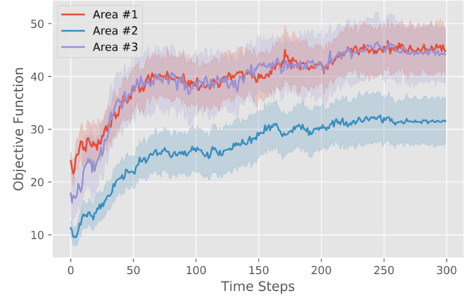
4. Evaluation Results | Different Operational Areas Performance
Figure 4.1

Slide 15
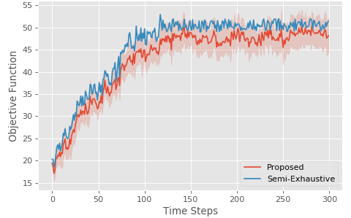
4. Evaluation Results | Semi-Exhaustive Comparison
Figure 4.2

Slide 16
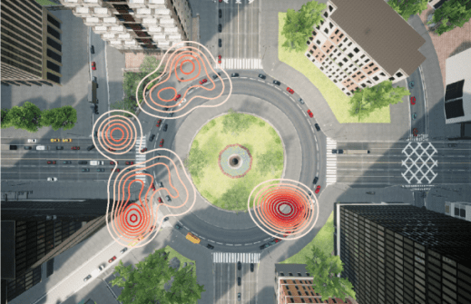
4. Evaluation Results | Areas of Convergence
Figure 4.3

Slide 17
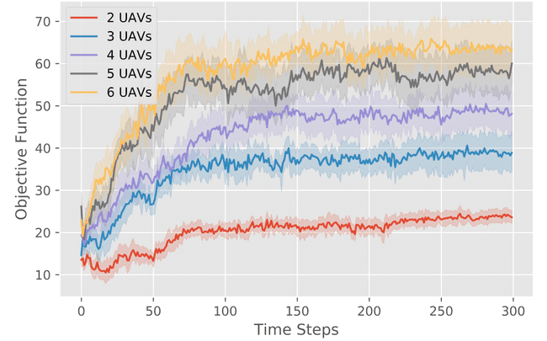
4. Evaluation Results | Scale up Study
Figure 4.4

Slide 18
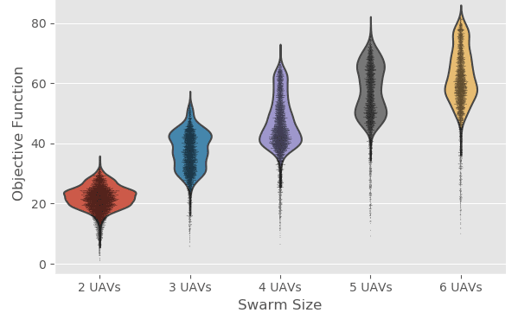
4. Evaluation Results | Scale up Study
Figure 4.5

Slide 19
5. Conclusion – Future Work
Conclusion
A semi-distributed algorithm for optimizing the monitoring positions for a swarm of UAVs: 1. No prior knowledge of the UAVs/environment dynamics 2. Active feed back (real-time) 3. BCD convergence characteristics
Extensive evaluation AirSim platform
Future Work:
Completely decentralized algorithm
Real-world set-up
Monocular depth estimation

Slide 20
More info here
Thank you for your attention

